Slide 1
2025 Standards – Insights ASQA Webinar 28 November 2025

Slide 3
Webinar overview
Updates from ASQA
Key insights from regulatory activities
How to access help
Useful tips
Questions

Slide 4
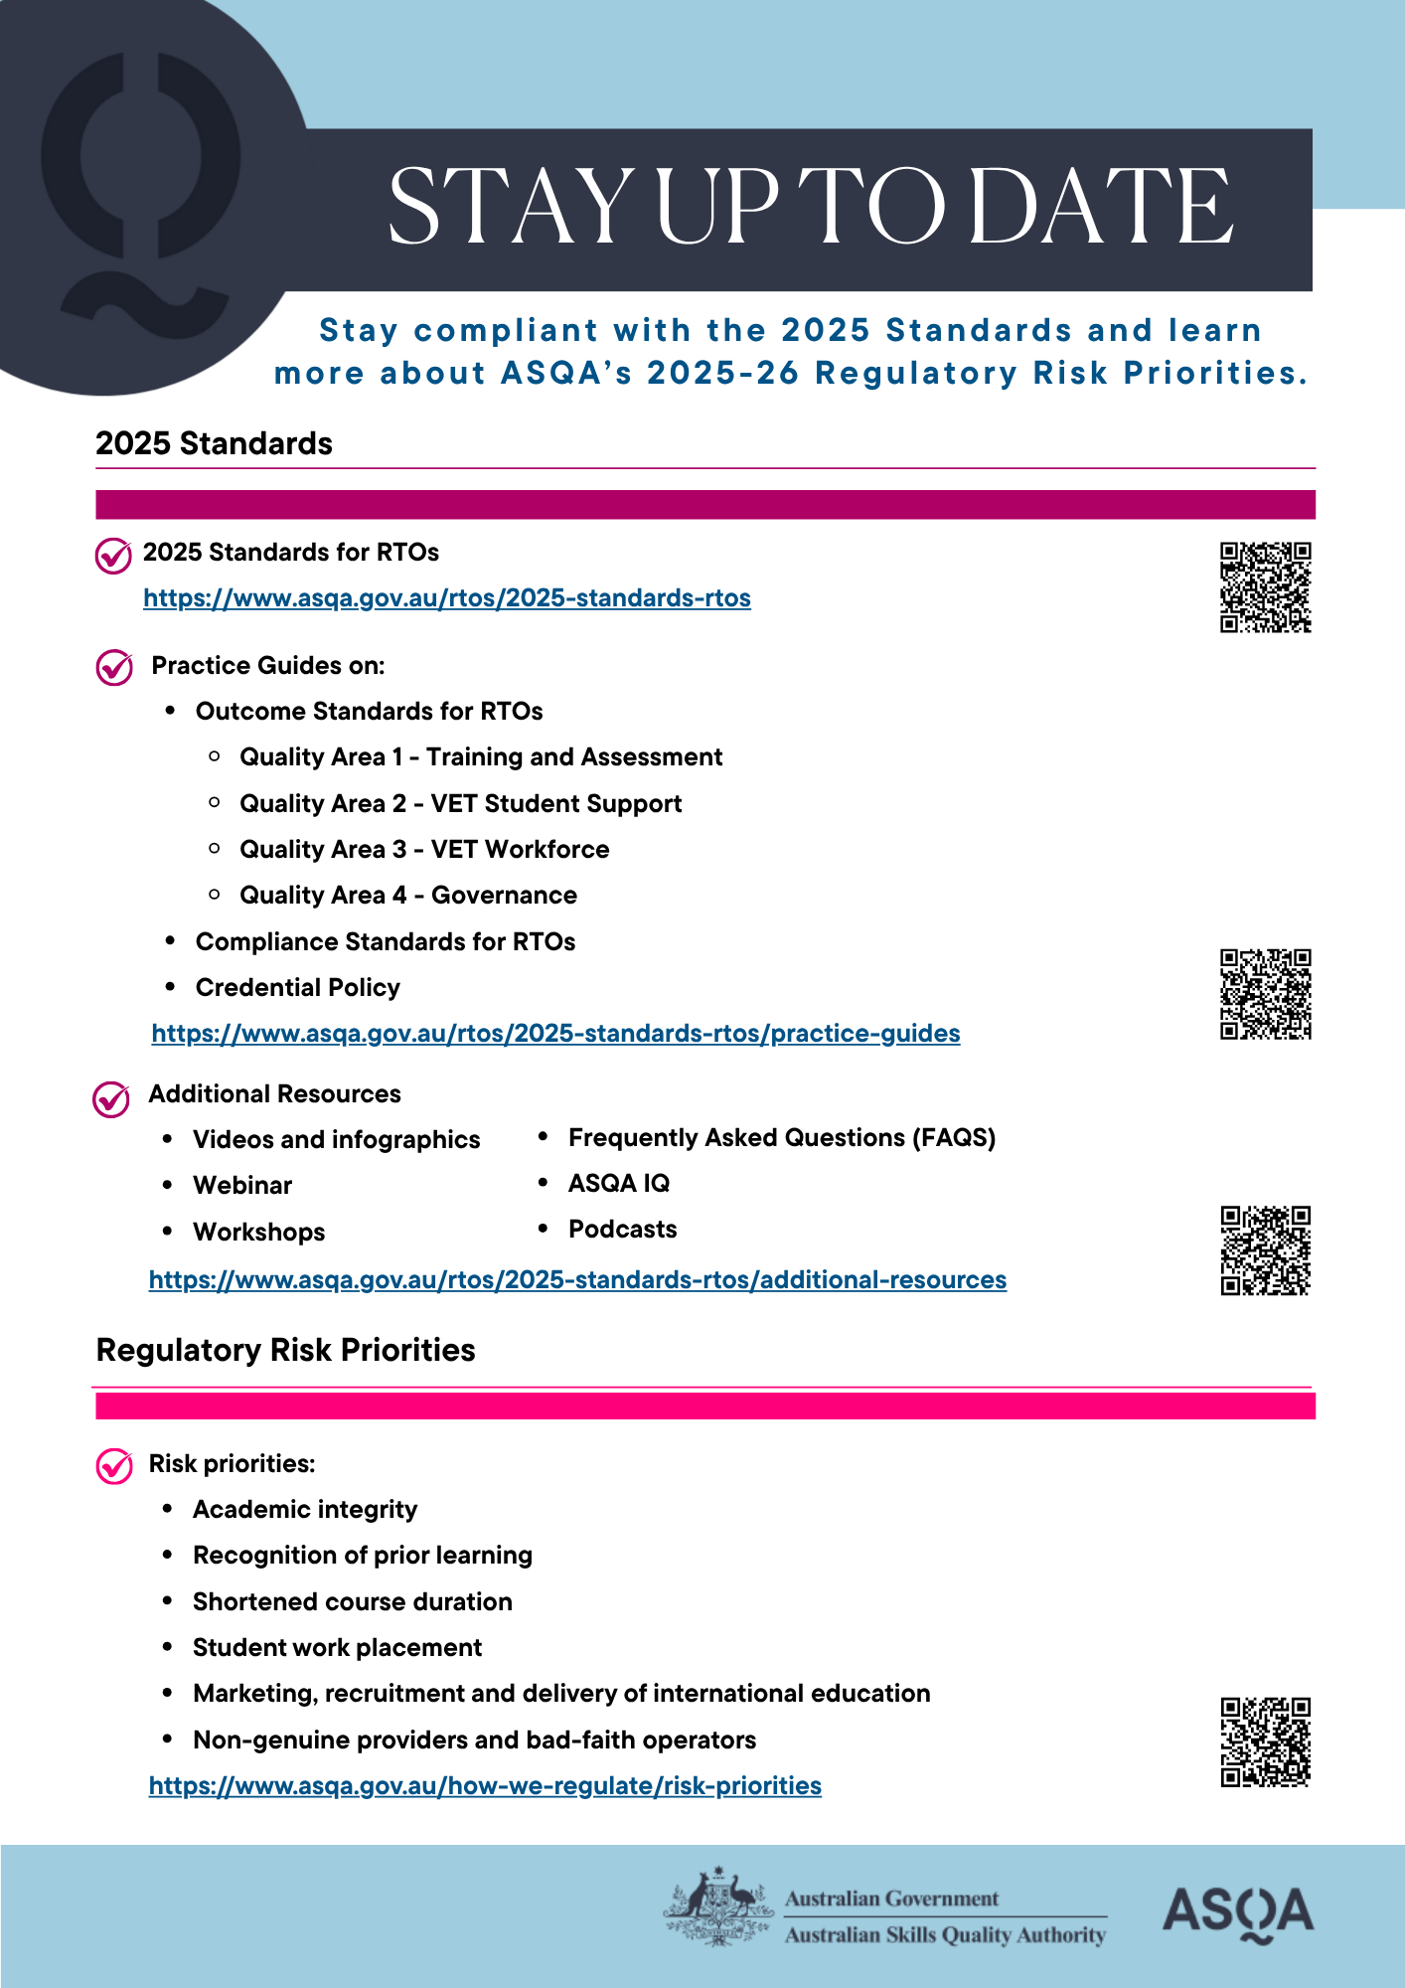
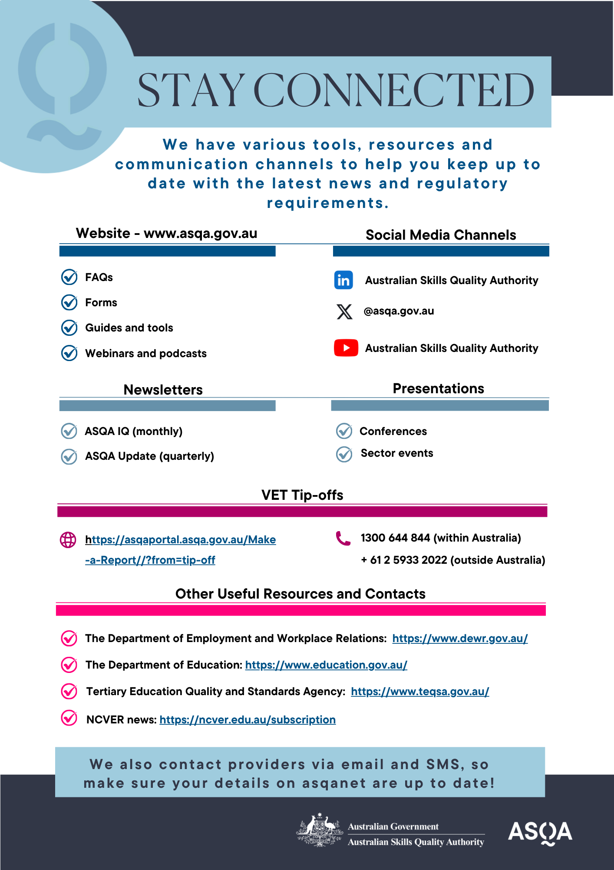
Today’s slides and the webinar recording will be available on our website afterwards
Resources are available to download

Slide 5

Ask Us ….
We have received over 100 pre-submitted questions through the webinar registration process
You can submit questions through the live-stream ‘question’ function

Slide 6
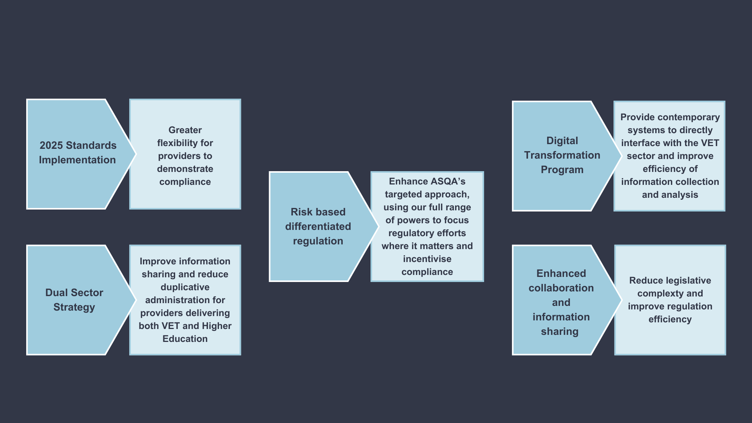

‘Smart Regulation’ measures
ASQA regulates
3,837 providers

Slide 7


Poll
How well do you understand the 2025 Standards now that we are 5 months into implementation?

Slide 8

How well do you understand the 2025 Standards now that we are 5 months into implementation?
4%

Slide 9

Key insights from regulatory activities

Slide 10
2025 Standards
Came into effect 1 July 2025
Recognised need to lift quality and integrity
More flexibility and innovation in VET delivery
Move away from a focus on administrative processes and prescription
Better reflect the diversity of the VET sector and different RTO settings.

Slide 11







ASQA's regulatory approach includes:
Assessments against Standards
Assessments against NVETR or ESOS Acts
Site visits
Requests for information:
self-assessment
to submit data
complete a survey
Phone interviews
Investigations

Slide 12
What have we been up to?
Since 1 July, ASQA has:
Reviewed more than 83 applications to become an RTO
Assessed more than 150 providers
Kicked off a range of campaigns, including one with RTOs that deliver Early Childhood Education and Care training
Focused on our own quality assurance and quality checks

Slide 13
Case Example: Provider Z
Due for registration renewal
Audit (assessment of performance against the Standards) undertaken
Last had an assessment in 2019
 | 2025
Report | 223 pages down to 10 pages
Time | Approx 55%
Duration | 4 months down to 28 days

Slide 14
2025 Standards – Insights from Performance Monitoring
Areas of Concern:
Poor quality assessment systems or practices is the most common issue identified during provider performance assessments (Outcome Standard 1.4)
Unsuitable or unqualified trainers and assessors is the issue most commonly found, as having the highest consequences if left unchecked (Outcome Standard 3.3)
Positive trends:
Diversity and inclusion, and student wellbeing (Outcome Standards 2.5 and 2.6)

Slide 15
2025 Standards – Insights from Performance Monitoring
Most common Outcome Standards being found not-met are:
Outcome Standard 4.4 An NVR RTO undertakes systematic monitoring and evaluation of the organisation to support quality delivery and the continuous improvement of services (not-met on 21 occasions)
Outcome Standard 1.4 The assessment system ensures assessment is conducted in a way that is fair and appropriate and enables accurate assessment judgement of VET student competency (not-met on 19 occasions)
Outcome Standard 3.3 Training and assessment is delivered by persons with current industry skills and knowledge relevant to the training product (not-met on 16 occasions)
Outcome Standard 1.1 Training is engaging, well-structured and enables VET students to attain skills and knowledge consistent with the training product (not-met on 15 occasions)

Slide 16
2025 Standards – Insights from Market Entry Assessments
Areas of Concern:
Quality of training
Poor quality assessment systems or practices
Ineffective or unsuitable organisational leadership
Positive trends:
Training package transitions
Intended management of overseas students

Slide 17
2025 Standards – Insights from Registration Management
Areas of Concern:
Poor quality and inadequate facilities, resources or equipment
Unsuitable or unqualified trainers and assessors

Slide 18
Key themes in our enquiries
No. | Key Theme
1 | Fit and Proper Person Requirements
2 | Training (training product requirements, training techniques, work placement, industry engagement)
3 | Credential Policy (trainer and assessor competencies)
4 | Integrity of Nationally Recognised Training (transition of training products, issuance of quals)
5 | Accountability (Annual Declaration on Compliance, Total VET Activity Data, material changes, prepaid fee protection)
6 | Assessment (assessment systems, assessment tools, validation)
7 | Feedback, complaints and appeals
8 | Recognition of Prior Learning and Credit Transfer
9 | Training support
10 | VET Workforce Management (professional development, staffing)

Slide 19

Accessing help

Slide 20
Poll
Which area of the 2025 Standards do you most need support with to fully understand and implement?

Slide 21
Which area of the 2025 Standards do you most need support with to fully understand and implement?
7%

Slide 22
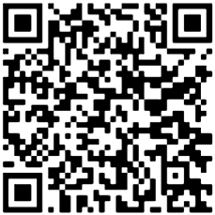

Practice Guide library
Training
Wellbeing
Information & Transparency
1
8
15
Assessment
Feedback, Complaints & Appeals
Integrity of Nationally Recognised Training Products
2
9
16
Recognition of Prior Learning & Credit Transfer
10
VET Workforce Management
Accountability
3
17
Facilities, Resources & Equipment
Trainer & Assessor Competencies
Fit & Proper Person Requirements
4
11
18
Information
Leadership & Accountability
19
Credential Policy
5
12
Training Support
13
Risk Management
6
Diversity & Inclusion
Continuous Improvement
7
14
https://www.asqa.gov.au/how-we-regulate/revised-standards-rtos/practice-guides

Slide 23
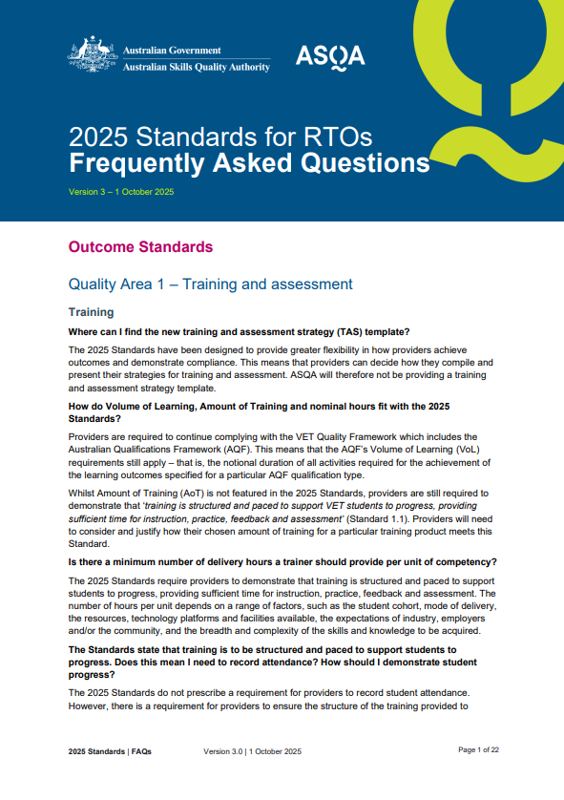
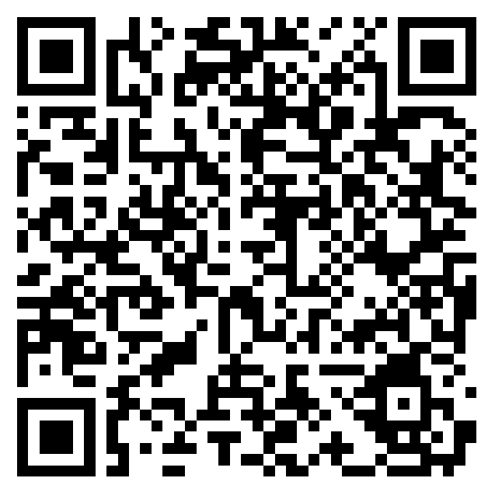
Frequently asked questions
www.asqa.gov.au/media/2585

Slide 24




2025 Standards – additional resources

Slide 25
Useful tips for providers

Slide 26

Tips on training
Align delivery mode with training product requirements
Structure training for logical progressions
Set an appropriate pace

Slide 27
Tips on assessment
Fairness: Build in reasonable adjustments
Flexibility: Contextualise assessment
Validity: Include practical demonstrations
Reliability: Standardise assessor judgements

Slide 28
Tips on governance
Keep Fit and Proper Person Declarations current
Lead by example
Promote transparency and accountability
Define roles clearly

Slide 29
Tips on facilities, resources and equipment
Conduct regular internal audits
Consider maintaining resource mapping documents that link to units of competency
Engage with industry, employers and the community
Ensure sufficient quantity and quality of equipment
Have a plan and a budget for maintenance and upgrades

Slide 30
Tips on trainers and assessors
Ensure you have a sufficient number of trainers and assessors
Allocate time for professional development
Understand the requirements of the Credential Policy
Verify trainer and assessor credentials

Slide 31
Reminders
Notification of material changes – 10 business days
Annual Declaration on Compliance – March 2026
Ensure your details are up to date – asqanet, training.gov.au, PRISMS (if applicable)
Total VET Activity Data submission deadline - 28 February 2026

Slide 32
Poll
What do you think of ASQA’s educational guidance so far on the 2025 Standards?

Slide 33
What do you think of ASQA’s educational guidance so far on the 2025 Standards?
4%

Slide 34
Your
Questions
Answered

Slide 35
Q1 – Will the next Annual Declaration on Compliance cover both 2015 Standards and 2025 Standards?

Slide 36
Q2 – Will ASQA be releasing an audit tool/template that RTOs can use to assess themselves against the 2025 Standards?

Slide 37
Q3 – Standard 4.4(c) - mechanisms to collect feedback for continuous improvement. What advice do you have for small RTOs that have few and familiar trainers where collecting feedback can appear repetitive and limited?

Slide 38
Q4 – In what situations could an RTO refuse to grant Credit Transfer for a unit or units completed with an RTO from another state or territory?

Slide 39
Q5 – Under the 2025 Standards, does an RTO have to offer RPL and have RPL resources ready for each qualification on scope?

Slide 40
Q6 – Are language, literacy and numeracy and digital literacy assessments mandatory for fee-for-service students?

Slide 41
Q7 – If using a third party for VET delivery, are both the RTO and the third party required to have the training product on scope?

Slide 42
Q8 – How does ASQA identify a provider risk? How does this trigger a performance assessment?

Slide 43
What you can expect over the next 6-12 months
Updates to our Practice Guides
Another series of face-to-face workshops
Further webinars and resources
ASQA continuing to engage with the sector through different regulatory activities (such as phone call programs)

Slide 44

We want to hear from you

Slide 45


asqa.gov.au
Tip-off Line: 1300 644 844
asqagovau

