Slide 1
2025 Standards
ASQA Information Webinar
27 June 2025

Slide 3
Webinar overview
The 2025 Standards are here!
Key themes from our workshops
ASQA’s regulatory / assessment approach
What is next? How can ASQA support you?

Slide 4
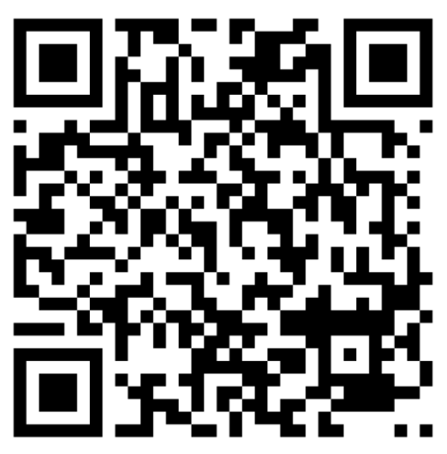
Ask Us ….
We have received over 120 pre-submitted questions through the webinar registration process
Also 450+ questions received through the workshops
For today, there are two options:
  Use the QR code
  Use the live-stream ‘question’ function

Slide 5
Today’s slides will be available on our website early next week
A link to the recording will be available on our website within the next fortnight

Slide 6
How will the 2025 Standards benefit your RTO?
WIIFM ?
Opportunity to innovate & differentiate your business from other providers
Less prescription on ways of doing things
More flexibility to choose how you will demonstrate compliance, quality and continuous improvement
Empowerment to use your judgement in designing and delivering the best training and assessment approach for your student cohort

Slide 7
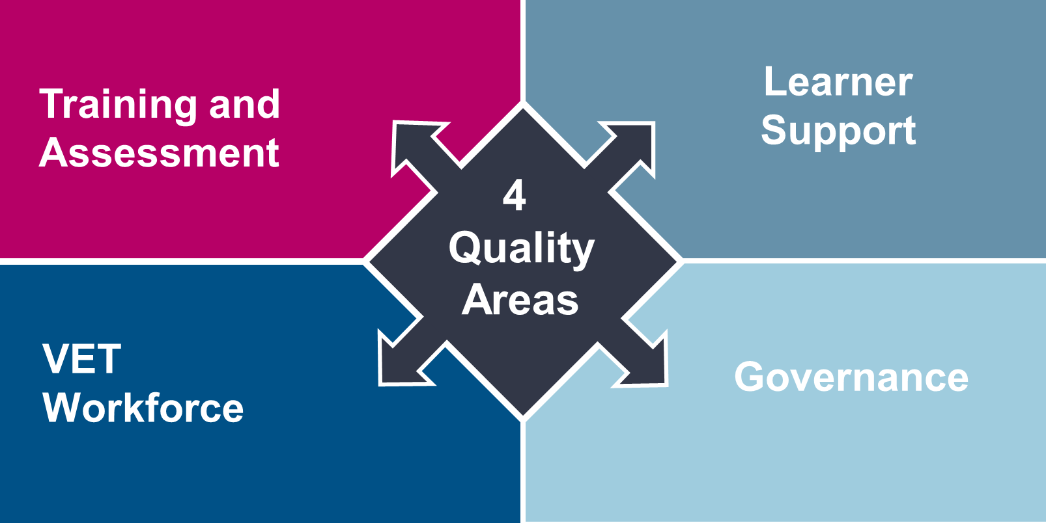

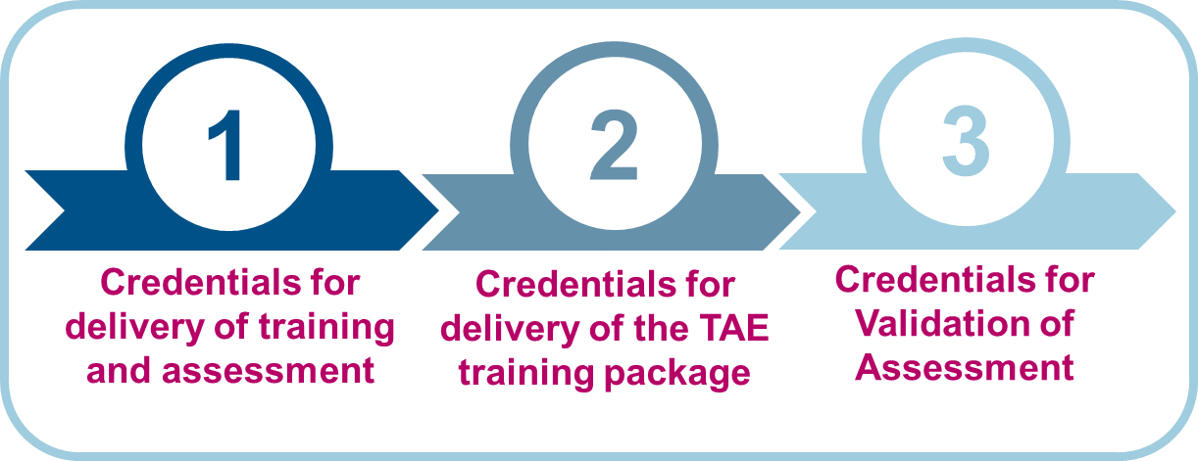
2025 Standards for RTOs
 | Outcome Standards | Compliance Requirements | Credential Policy
Purpose | Sets out the quality outcomes providers are expected to achieve | Sets out binary requirements | Applies to VET workforce; enforceable via Outcome Standards
Focus | Training and assessment VET Student Support VET Workforce Governance | Information and Transparency Integrity of NRT products Accountability Fit & Proper Person Requirements NRT Logo | Credentials for the delivery of training and assessment Credential requirements for the delivery of training and assessment for training products from TAE Credentials for Validation of Assessment
Official Title | National Vocational Education and Training Regulator (Outcome Standards for Registered Training Organisations) Instrument 2025 | National Vocational Education and Training Regulator (Compliance Standards for NVR Registered Training Organisations and Fit and Proper Person Requirements) Instrument 2025 | Credential Policy
Where to find | Federal Register of Legislation | Federal Register of Legislation | National Training Register
NOTE: The instruments and policy are of equal importance and enforceable

Slide 8
2025 Standards Document Hierarchy
Legislative Instruments
Federal Register of Legislation
Outcome Standards
Compliance Requirements
Credential Policy (on National Register)
Policy Guidance
DEWR website
Outlines the policy intent for each Outcome Standard
Practice Guides
ASQA website
A library of guides by topic
Other educative resources

Slide 9
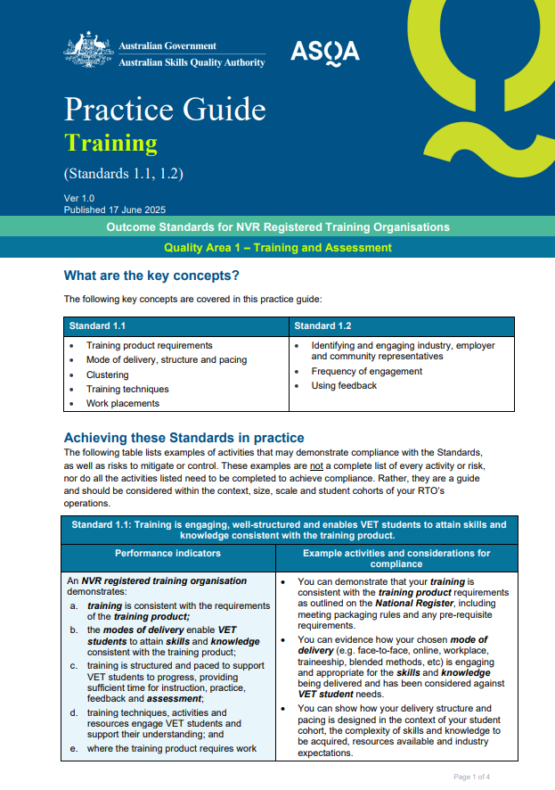
Practice Guides
Examples of what ‘good’, ‘great’ and ‘poor’ might look like
Not a prescriptive checklist
Prompt providers to consider the context of their operations, their student cohort/s and scope of delivery
Language is intended to focus providers’ attention on demonstrating how their approach is being applied to achieve the intended outcomes

Slide 10
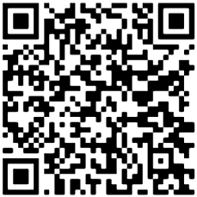

Practice Guide library
Training
Wellbeing
Information & Transparency
1
8
15
Assessment
Feedback, Complaints & Appeals
Integrity of Nationally Recognised Training Products
2
9
16
Recognition of Prior Learning & Credit Transfer
10
VET Workforce Management
Accountability
3
17
Facilities, Resources & Equipment
Trainer & Assessor Competencies
Fit & Proper Person Requirements
4
11
18
Information
Leadership & Accountability
19
Credential Policy
5
12
Training Support
13
Risk Management
6
Diversity & Inclusion
Continuous Improvement
7
14
https://www.asqa.gov.au/how-we-regulate/revised-standards-rtos/practice-guides

Slide 11
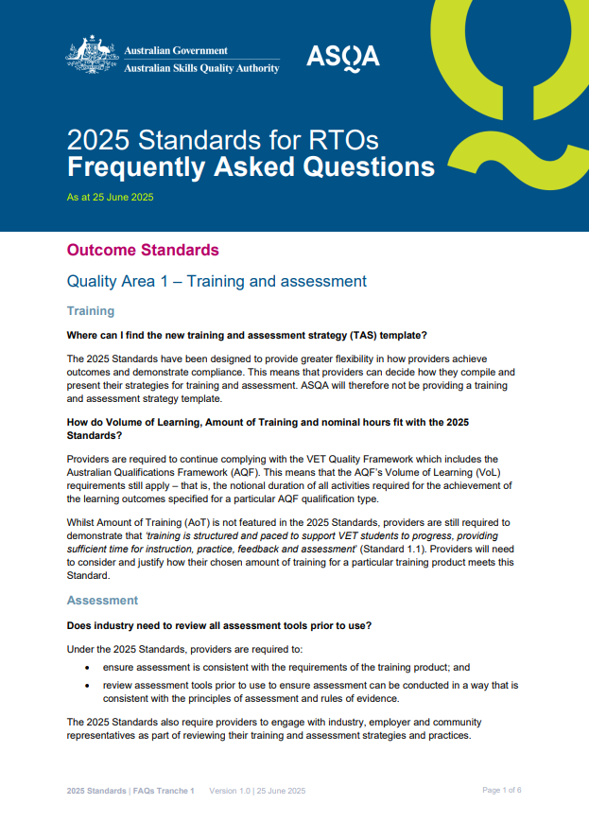
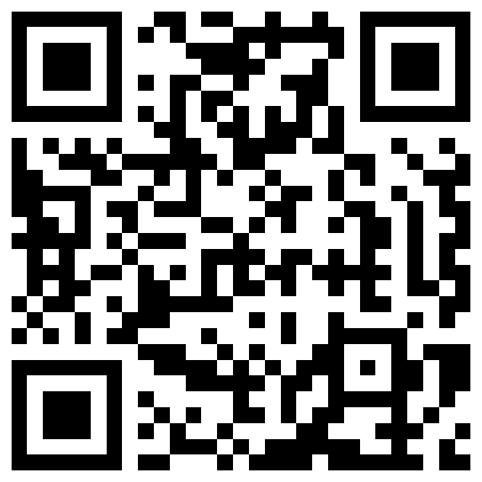
FAQs
FAQs are now available
You have early access via the QR code below to the first tranche
If you have other questions about the 2025 Standards, you can email standards@asqa.gov.au
https://www.asqa.gov.au/media/2570

Slide 12
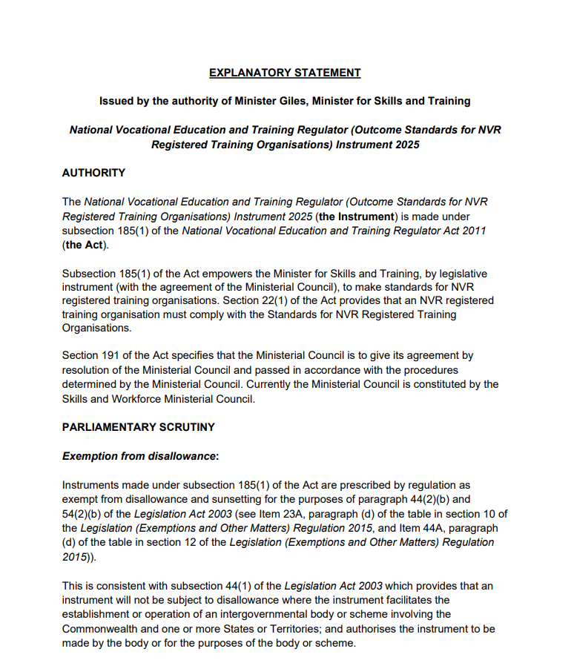
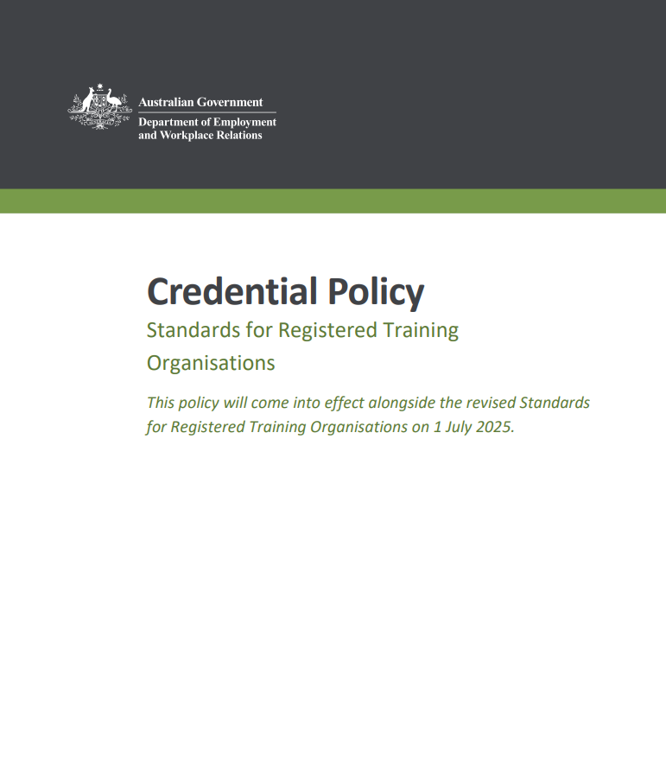
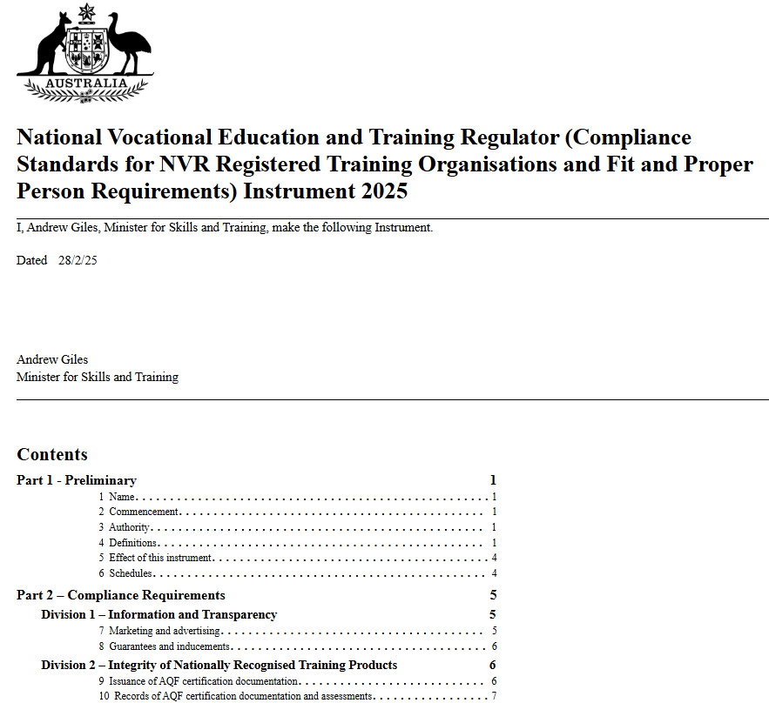
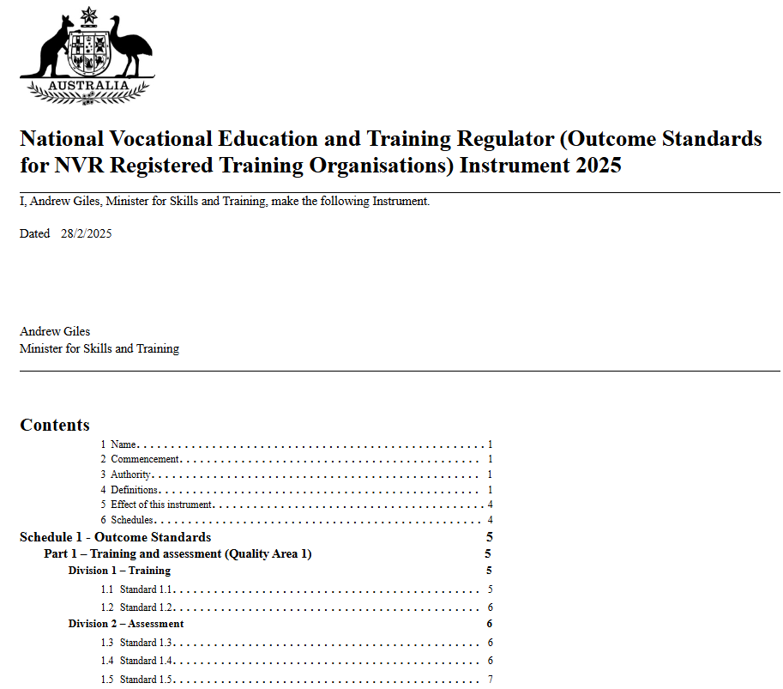
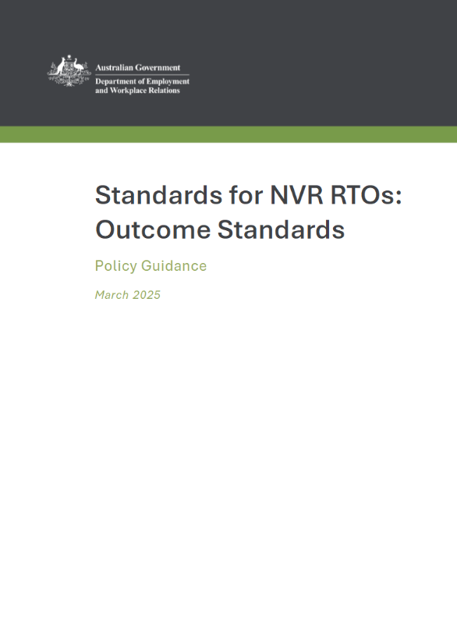
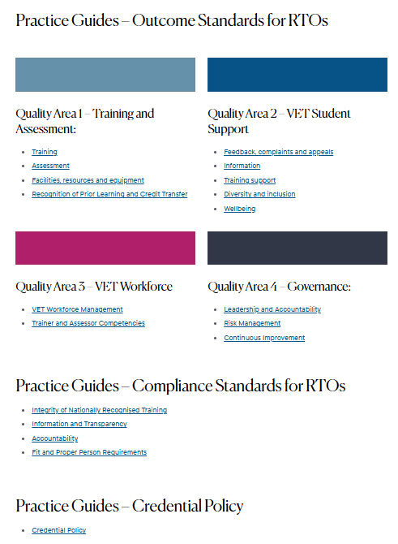
How should you prepare?
Familiarise yourself with:
  both Instruments - including the definitions and explanatory statements
  Credential Policy
  Practice Guides
  DEWR's Policy Guidance document
Review your policies, practices and resources
Support your staff to adapt to the 2025 Standards

Slide 13
ASQA's Standards Information Workshop Series
What we learnt...

Slide 14
Key themes shared at the workshops
Change to an outcomes-focus, but intent remains the same (high quality VET)
Less prescription – greater flexibility for providers to demonstrate how they comply
Compliance is required against all Standards, down to performance indicator level
The ‘new’ elements of the Standards - Diversity & Inclusion, Student Wellbeing, strengthened Governance – will require adaptation and uplift by many providers
Credential Policy – providers should check their compliance - for example, no “assessment teams” or “co-assessing”
ASQA is adapting too, with a revised regulatory approach and assessment approach

Slide 15
What were you most interested in?
No. | Key Theme
1 | ASQA audits and assessment activities
2 | Third party arrangements
3 | Trainers and Assessors (including industry currency, providing direction, judgements)
4 | Record retention
5 | Standards transition
6 | Practice Guides
7 | Volume of Learning / Amount of Training
8 | Fit and Proper Person Requirements
9 | Student wellbeing
10 | ASQA practices
11 | Diversity & Inclusion
12 | Prepaid fee protection

Slide 16
Your preparedness, what you told us...
Question | In Person Workshops | Online Workshops
Rate your RTO's awareness of the need for revised Standards and an outcomes-based approach. | 4.43 out of 5 | 4.41 out of 5
Rate your RTO's motivation to support the change to the revised Standards and an outcomes-based approach. | 4.64 out of 5 | 4.66 out of 5
Rate your RTO's confidence in adopting the revised Standards. | 4.29 out of 5 | 4.32 out of 5
Rate your RTO's preparedness in adopting the revised Standards. | 3.97 out of 5 | 4.03 out of 5
Rate how valuable you found the workshop. | 4.49 out of 5 | 4.37 out of 5

Slide 17
ASQA’s revised assessment approach

Slide 18
ASQA is maturing too…
Maturing our regulatory approach
Maturing our assessment approach
Varied regulatory activities
More education & engagement
More clear & transparent
More efficient
Address areas of feedback overall
More consistent
Adopting the outcomes based approach

Slide 19








Examples of ASQA's Assessment and Monitoring Activities
  Assessments against Standards
  Assessments against NVETR or ESOS Acts
  Site visits
  Requests for information:
      self-assessment
      to submit data
      complete a survey
  Phone interviews
  Investigations

Slide 20
Revised Assessment Approach
Risk led
Varied ways to demonstrate your compliance
Consistency in assessments
Improved reporting
May or may not be driven by an application

Slide 21
Regulatory Assessment Process
Trigger
Plan
Assess
Complete

Slide 22
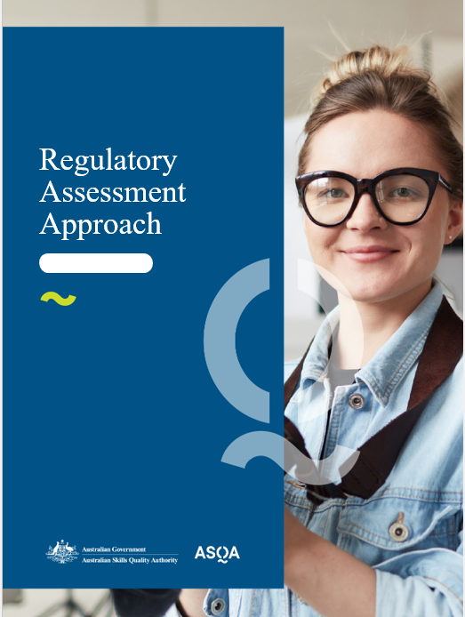
ASQA's
Regulatory Assessment Approach is coming...

Slide 23
Transition Principles
Providers due for renewal must be considering how they meet the revised Standards.
In general, applications for change of scope or course accreditation under assessment, will not be impacted by Standards transition
Regulatory activities that are currently in train may be assessed against the revised Standards
ASQA’s compliance and enforcement powers have not changed

Slide 24
Share your approach with us..
Some of the best learning is from each other
Send us your examples of best practice or how you have implemented the 2025 Standards
Feature in our materials (identified or de-identified)
Email standards@asqa.gov.au

Slide 25
ASQA's Implementation Plan Jul-Dec 2025
Continued engagement
Increased communication and support
Building on our materials including case studies
Monitoring implementation and keeping you in the loop
Formal evaluation

Slide 26








ASQA’s Education and Engagement Pipeline
ASQA IQ
Webinars
FAQs
ASQAcast
(Podcasts)
www.asqa.gov.au
Website updates
Animations
and Video content
ASQA Presents
(online presentations)
Socials

Slide 27
Your
Questions
Answered

Slide 28
Q1 - Is there a checklist we can use to ensure we have covered off everything before 1 July?

Slide 29
Q2 – Does ASQA expect that all RTO's will have completed a revision of their policies and procedures against the 2025 Standards by 1 July?

Slide 30
Q3 - I’ve heard that, from 1 July, RTOs will need to comply with both the 2015 and 2025 Standards. Is this correct?

Slide 31
Q4 - How can we ensure we are meeting cultural respect and safety, and student wellbeing expectations?

Slide 32
Q5 - Do trainers and assessors working under direction still require a supervision plan?

Slide 33
Q6 - How many hours of professional development per year would be considered appropriate to maintain relevant and current industry competencies?

Slide 34

Key take aways:
Engage with the instruments and materials – what do you need to change or implement?
  2025 Standards come into regulatory effect from 1 July 2025
  ASQA’s regulatory approach & assessment approach are also maturing
  Providers with activities underway will be advised if additional information is required
  Download our FAQ’s now via this QR code

Slide 35
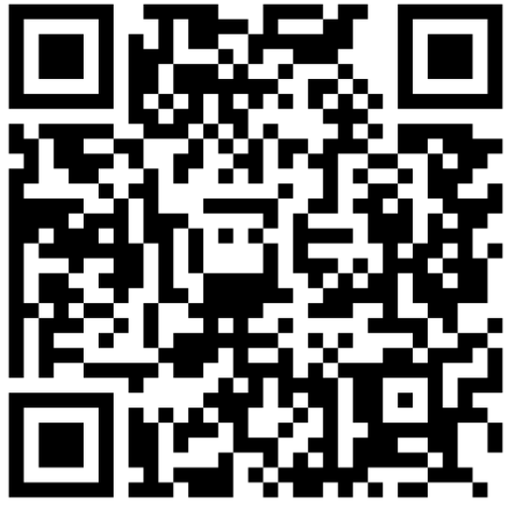
We want to hear from you
https://surveys.asqa.gov.au/n/91XtLol

Slide 36


asqa.gov.au
Tip-off Line: 1300 644 844
asqagovau

